Slide 1

Welcome to the Agency Field Supervisor/Instructor Training!
The training will begin at 12:00pm CST
Notes:
BER

Slide 2
Agency Field Supervisor/Instructor Training
Housekeeping:
Attendance and CEUs
    Please type your name and email address into the chat
Multiple Viewers?
    Include their information in the chat too
Recording
    Video On/Off
    Future Viewing
Notes:
BER

Slide 3
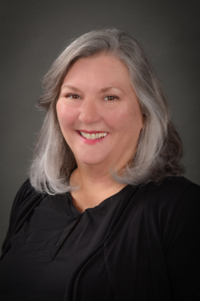
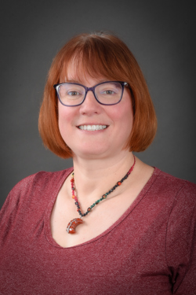
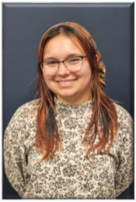
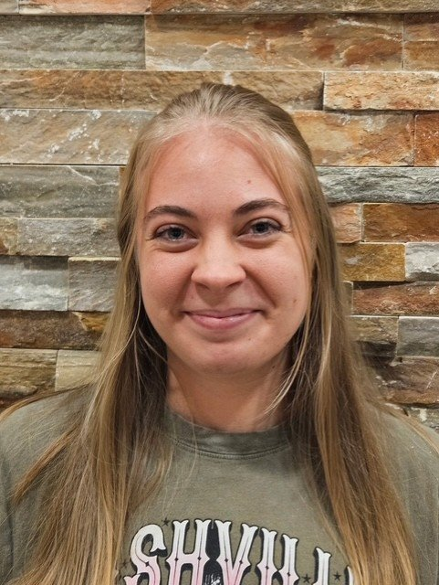
Welcome from the Field Team!!
Bonnie Rinks, LCSW, ACSW
Director
Field Education
812-465-1106 office
or
812-204-5848 cell
berinks@usi.edu
Brandi Watson, LCSW,
Assistant Director
Field Education
(812) 461-5411 office
bewest@usi.edu
Grace Brown, BSW
Graduate Assistant
Field Education
Socialwork.field@usi.edu
Madison Piatt
Student Worker
Field Education
Socialwork.field@usi.edu

Slide 4
OASAS
Online Advanced Studies in
Addiction Science
100% online Masters Certificate in Addiction Science
Designed for individuals with a Master of Social Work degree
For more information contact the MSW Program Director Dr. Quentin Maynard at qrmaynard@usi.edu

Slide 5
Online MSW
USI’s Social Work Department now offers an online MSW program
Officially launched in Summer 2024!
For more information contact the MSW Director at qrmaynard@usi.edu

Slide 6

Why are we doing this?
To Relieve Stress and Clarify Expectations
The mission of Field Education is to turn students’ focus from the acquisition of knowledge to the application of knowledge.
In field, students are provided with opportunities to apply the social work knowledge and skills obtained in the classroom to actual practice situations.
When a student completes field, they should be ready to enter the profession.
We hope this training helps clarify expectations, and eliminate some
of the stress that can be associated with Field Education.

Slide 7

Teaching Soon-To-Be Social Workers
Agency Field Supervisors assist students in mastering competencies, knowledge, values, and skills that they have learned in the classroom to the practice setting
This involves creating learning opportunities for students to integrate theory and practice.
Help them learn to be Social Workers!

Slide 8
Agenda/Topics to Be Covered
How We Place Students
Who’s Who and Their Roles
Council on Social Work Education (CSWE)
Competencies and Practice Behaviors
Student Learning Plans (SLP)
If Problems Occur
Frequently Asked Questions (FAQs)
What’s New

Slide 9

TEVERA Change to Experiential Learning Cloud (ELC)
May 21st TEVERA transitioned to Experiential Learning Cloud (ELC)
There is no required actions due to this change
The format of the site is almost identical, with minor changes
Updates will roll out incrementally, students will be notified of any changes impacting them

Slide 10
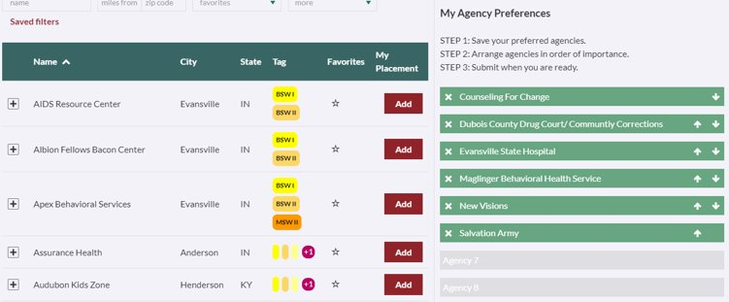
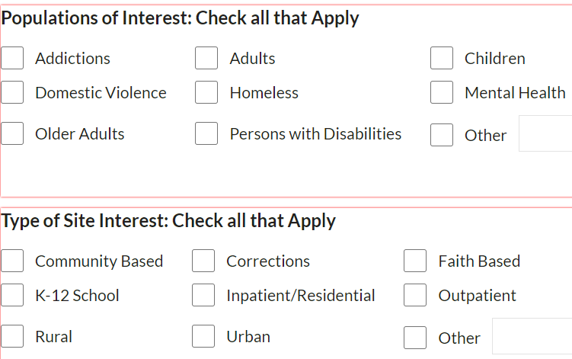
Placing Students
During the Field Application Process:
Students review the list of agencies USI Social Work has agreements with.
Then send a wish list of their internship agency preferences from 1-5.
They are also asked what populations and setting they prefer gaining experience in.

Slide 11
Placing Students: Continued
Authorization: Field Education reviews student preferences and authorizes student contact
Communication: Student emails a resume and cover letter to the agency requesting an interview.
Interview: If it is a good fit, a form is sent to the agency via ELC to complete the process.
  Please assure ALL of these are complete BEFORE the semester starts!
Prior to Start Date: Students should be oriented (i.e. schedule, dress code, policies & procedures, where to park, where they will do their work, etc.)
If you have an intern(s) this fall, they should be in contact with you. If you have not heard from your student intern(s), please let us know. ☺
Notes:
SNW

Slide 12

Who’s Who?
Agency Field Instructor/
Supervisor
&
Task Instructor/Supervisor
BSW & MSW Students
Faculty Field Liaison/
Seminar Instructor
Agency
Intern
University Faculty

Slide 13
Who can supervise interns?
Generalist:
  BSW I & II and MSW I - social work students must be supervised by a BSW, LBSW, LSW, or LCSW
  Supervisor without social work degree can be task supervisor. Students will be required to meet with a licensed supervisor to provide 1 hour of supervision a week.
Clinical:
  MSW II – must be supervised by LCSW
  For clinical students also seeking OASAS certification supervision must be by an LCSW and or LCAC with 5 years experience.

Slide 14
A Task Instructor/Supervisor is someone within the agency that the Agency Field Instructor/Supervisor assigns the intern to learn a specific skill or experience with a particular population.
  Example: If I work only with adults with SMI and I was the Agency Field Instructor/Supervisor for an intern, I could assign the intern to work with a child and adolescent therapist within my agency. I would remain the supervisor, but the student would get the experience of working with children.
The Task Instructor/Supervisor and the Agency Field Instructor/Supervisor would need to communicate with each other on the intern’s progress.
Task Instructor*/ Supervisor’s Roles
*This is an optional agency role

Slide 15
Advanced Clinical Student: MSW II
All USI MSW students complete a clinical field practicum.
The advanced clinical placement provides agency-based opportunities for clinical social work practice.
The focus of a clinical practicum is to provide students with opportunities to demonstrate CSWE’s competencies at the clinical level of social work practice.
The clinical practicum is advanced; reflecting the specialized knowledge, skills, and values of an advanced clinical practitioner.
MSW II field placements provide a mix of generalist and clinical activities, with the emphasis being on the student developing therapeutic skills.
Advanced Clinical Students MUST be supervised by an LCSW

Slide 16
Student’s Role
  Reflect on the tasks of the week
  Explore any conflictual feelings
  Exercise critical thinking skills
  Focus attention to the Student Learning Plan (SLP), including CSWE Competencies
  Master the NASW Code of Ethics
  Be open to feedback
  Set a mutually agreed upon schedule and stick to it
  Facilitate communication between Faculty Field Liaison/Instructor and Agency Field Supervisor/Instructor

Slide 17
Faculty Field Liaisons
Clinical
Generalist
Dr. Kathy Elpers, LCSW
kelpers@usi.edu
Ms. Patty Loehr, LCSW, LCAC
loehr@usi.edu
Ms. Janis Lotfalian, LCSW, LMFT
  jelotfalia@usi.edu
Ms. Brandi Watson, LCSW
bewest@usi.edu
Ms. Elizabeth Fallen, LCSW
eafallen@usi.edu
Mr. James Akin, LCSW, LCAC
  jaakin@usi.edu
Dr. Veronica Huggins, LMSW vchuggins@usi.edu
Ms. Phyllis Stone, MSW, CDVA
  pkstone@usi.edu
Ms. Heather Woods, LCSW, LCAC
  hmwoods@usi.edu

Slide 18
Faculty Field Liaison/Seminar Instructor’s Role
Conduct seminar class to connect and process academic learning with practicum field experience.
  Personal growth of the student - Strengths and Challenges
  Constructive, honest, and direct feedback
  Professional standards of Social Work
  NASW Code of Ethics
Assure student is meeting CSWE Competencies on the Student Learning Plan (SLP) and in Social Work practice
Meet with student and Agency Field Supervisor/Instructor at midterm and final to evaluate and sign SLP
Communicate with Agency Field Supervisor/Instructor on student progress, as needed

Slide 19
Field Instructor/Supervisor’s Roles
Responsible for Student’s Educational Field Experience at Agency
Assure student is meeting CSWE Competencies on the Student Learning Plan (SLP) and in Social Work practice
Utilize and communicate with Task Supervisor
Meet with student and USI Faculty Field Liaison at midterm and final to evaluate and sign SLP
Reviewing & Signing times sheets each week
Provide Formal Supervision* focusing on:
  Personal growth of the student - Strengths and Challenges
  Constructive, honest, and direct feedback
  Professional standards of Social Work
  NASW Code of Ethics
*CSWE requires Agency Field Instructors/Supervisors to provide at least 1 hour per week for student supervision.

Slide 20
Boundaries With Interns
Keep supervision structured and goal-focused: Sessions should prioritize the intern’s learning, ethical development, and clinical growth—not the supervisor’s personal experiences or unrelated opinions.
Maintain role clarity: The supervisor is a mentor, evaluator, and gatekeeper—not a therapist, friend, or confidant.
Model ethical practice: Supervisors must demonstrate adherence to the NASW Code of Ethics and agency policy to model best practices for interns.
  Avoid: Ignoring or minimizing ethical concerns the intern raises
Avoid over-identification: Supervisors should not project their own past experiences onto the intern’s current work or rely on the intern for emotional support.
Respect time limits: Keep supervision sessions on schedule and within boundaries. Don’t expect interns to be available outside of agreed hours.
Confidentiality: Interns' disclosures during supervision should be respected, but supervisors must inform interns that some information (e.g., ethical violations, safety concerns) must be shared with appropriate parties.

Slide 21
Boundaries With Interns
Red Flags (What to Avoid)
  Blurring personal and professional lines (e.g., texting casually, socializing outside of work)
  Sharing confidential client info or personal stories excessively
  Ignoring or minimizing ethical concerns the intern raises
Reminders
  If interns are pushing for too many hours, you are allowed to remind them of their schedules and their role as an intern
  Reach out to seminar instructors or the field team if you are having boundary issues with your student

Slide 22
  Students may also need “checking in” time between Formal Supervision sessions for those teachable moments!

Slide 23
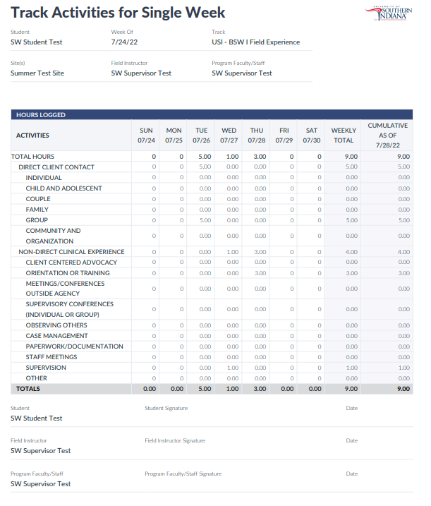
Time Sheets
Your student(s)’s time will be tracked via ELC this year.
The student will be responsible for completing the time sheet each week, capturing dates, times, and activities, including supervision.
  REMINDER: CSWE requires Field Instructors & Interns to meet for supervision on a weekly basis for a minimum of one hour
Once the student has completed the timesheet for the week, you will receive an email from ELC. You will “approve” their weekly hours & supervision from this email.

Slide 24
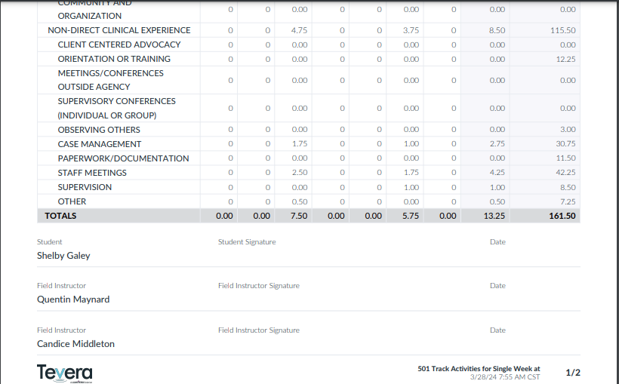
Time Sheets: Extra Notes
Some students may have both a Task Supervisor and a Field Instructor signing off on time sheets.
  The Task Supervisor signs to account for weekly completed intern hours
  The Field Instructor signs confirming at least 1 hour of supervision occurred for the week.

Slide 25

CSWE Competencies
The Social Work programs at USI are accredited by the Council on Social Work Education (CSWE), dictating specific core competencies and behaviors students must be able to demonstrate prior to graduation.
To stay current and encourage excellence CSWE updates these periodically. We have now transitioned to the 2022.
Field is the signature pedagogy of social work education. The elements of instruction and socialization teach future practitioners the fundamental dimensions of professional work in their discipline to think, perform, and act ethically and with integrity.
https://www.cswe.org/getmedia/94471c42-13b8-493b-9041-b30f48533d64/2022-EPAS.pdf
Notes:
BER

Slide 26
Competencies (1 of 2)
Competency 1: Demonstrate Ethical and Professional Behavior
Competency 2: Advance Human Rights and Social, Racial, Economic, and Environmental Justice
Competency 3: Engage Anti-Racism, Diversity, Equity, and Inclusion (ADEI) in Practice
Competency 4: Engage in Practice-Informed Research and Research-Informed Practice
Competency 5: Engage in Policy Practice

Slide 27
Competencies (2 of 2)
Competency 6: Engage with Individuals, Families, Groups, Organizations, and Communities
Competency 7: Assess Individuals, Families, Groups, Organizations, and Communities
Competency 8: Intervene with Individuals, Families, Groups, Organizations, and Communities
Competency 9: Evaluate Practice with Individuals, Families, Groups, Organizations, and Communities

Slide 28
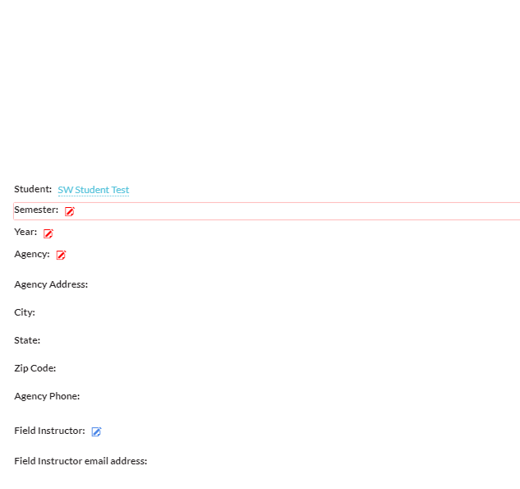

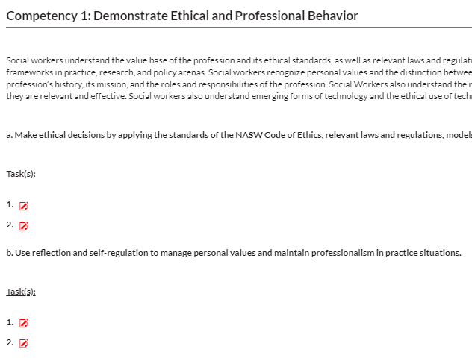
The SLP reports students’ comprehension of & ability to carry out CSWE’s Competencies of Social Work practice.
Student Learning Plan (SLP)
The student will complete this in ELC with feedback from their Agency Supervisor & Faculty Liaison.
Once the SLP is complete, you will receive an email from ELC for signature approval.

Slide 29
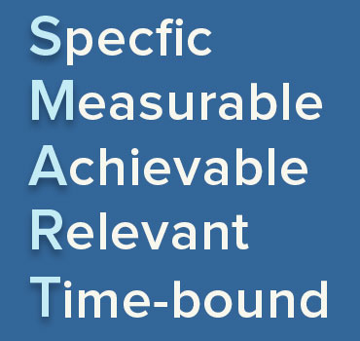
Turning Competencies Into Behaviors
When completing their SLP, the student needs to think about how to demonstrate mastery of the Core Competencies through behaviors carried out at your agency.
Students will write specific activities for each practice behavior
  These need to be S.M.A.R.T.!

Slide 30
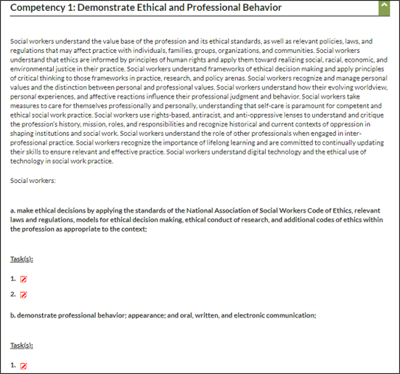
Student Learning Plan Examples
COMPETENCY 1.A
I will review the NASW Code of Ethics and agency policies at the beginning of the semester.
I will attend agency trainings throughout my internship.
COMPETENCY 1.B
I will follow agency dress code daily.
I will utilize agency technology in a responsible, ethical, and professional manner.

Slide 31
Scoring the Student Learning Plan (SLP)
RUBRIC
N/A | 1 | 2 | 3 | 4 | 5
Not applicable as the student has not had the opportunity to demonstrate competency. | This practice behavior has not yet emerged in the student's repertoire. | The practice behavior is beginning to emerge in the student's repertoire. | The student is developing behavior; consistency is anticipated within the parameters of the fieldwork hours required by the program. | The student is approaching consistent demonstration of and engagement in practice behavior. Consistency is anticipated in the near future. | The student consistently demonstrates/engages in this practice behavior.

Slide 32
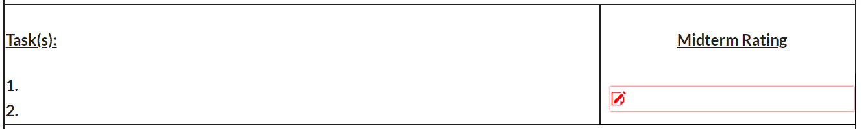
Scoring the Student Learning Plan (continued)
Midterm: a simple snapshot of the intern’s current progress
Scores
Your intern is learning; therefore it is not uncommon to see 2s & 3s at midterm.
  A 5 would mean they are ready to be a beginning social worker
If there are any N/As at midterm, address them
  Make a plan to accomplish that goal
  OR change the behavior to something that can be accomplished to master that competency
  SLP practice behaviors can be modified if needed
General
Address any problem areas
  This should not be the first time the student is hearing about it!
Provide feedback on what needs to be improved before the final evaluation

Slide 33

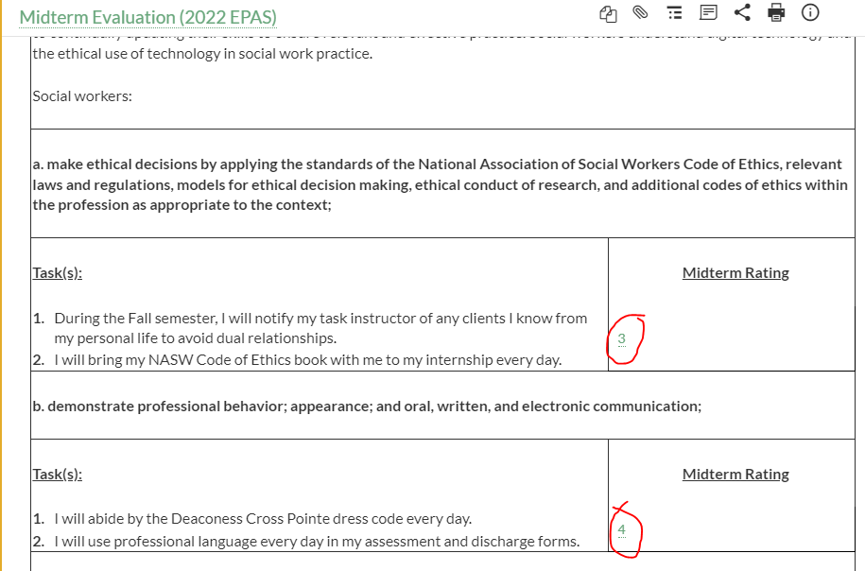
Midterm/final - MUST be scored before conducting the meeting

Slide 34

Assessing Professional Skills
Scoring the Student Learning Plan (continued)
At Midterm, you will Assess your Intern’s Social Work Skills and their Professionalism
    You will assess areas where social work skill growth is needed and plans to ensure this growth
    You will also assess the student’s professionalism, workplace skills, and appropriate use of supervision

Slide 35
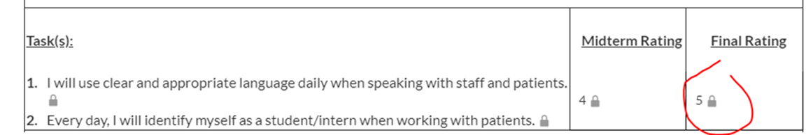
Scoring the Student Learning Plan (continued)
Final
We expect to see that students have mastered the competencies by the final; therefore, we expect to see 4s & 5s.
  Remember, we are expecting that these students can go into the field as a professional upon graduation.
NOTE: Please schedule 1 hour each for these meetings, however if there are no major issues, it should be about 20-30 minutes.

Slide 36
Midterm/final - MUST be scored before conducting the meeting

Slide 37
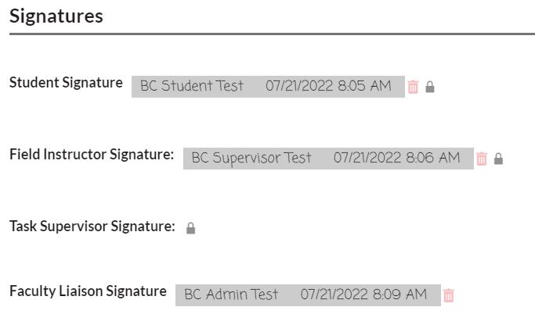
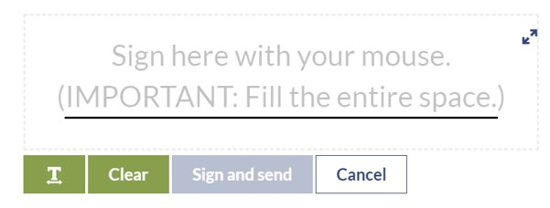

Signatures are extremely important!
All Signatures will be done on ELC. When Your Signature is Required, You Will Receive and Email.
    This can be done with your mouse or password.
Signatures make this document valid!

Slide 38
Grades
The USI Faculty Field Liaison has the responsibility of assigning a grade for the course. The grade that is assigned will be based on:
  Intern logs/journals
  Ethical and professional behavior
  Synthesizing course work and practice (seminar participation, assigned papers, as well as other assignments)
  The Faculty Field Liaison’s overall evaluation of the student’s performance in placement in conjunction with the Agency Field Supervisor’s evaluation.
Your input is valuable and desired!

Slide 39
If Problems Occur, We are here to help
Prevention is best. However, if problems occur...
Meet with the student to address concerns
  It is best to identify them early
  Address them directly and honestly
  Most students will correct any issue(s) once it is addressed in supervision
Document the area(s) where students need to make changes
Notify the Faculty Field Liaison*
  A meeting between the student, liaison, & supervisor may need to take place if the issue is not corrected
Immediate concerns to discuss with the Liaison:
  Attendance/Tardiness Issues
  Policy Violations/ Ethical issues
  Student resistant to feedback
*Liaison may also need to involve Field Director
  See Field Manuals for More Details: https://www.usi.edu/liberal-arts/social-work/field-education
Notes:
SNW

Slide 40
Some reasons for concern may include...
Unsatisfactory Performance
Unethical Conduct
  Violating agency policies, recordkeeping, attendance, tardiness, confidentiality, etc.
  Inability to cooperate in the learning process with field instructors/supervisor and/or professional colleagues
  Inability to meet learning expectations
  Physical or verbal assaults
  Violation of the University alcohol and drug policy
  Sexual misconduct
  Any violation of the NASW Code of Ethics.
See Field Manual for Complete List.
  https://www.usi.edu/liberal-arts/social-work/field-education

Slide 41
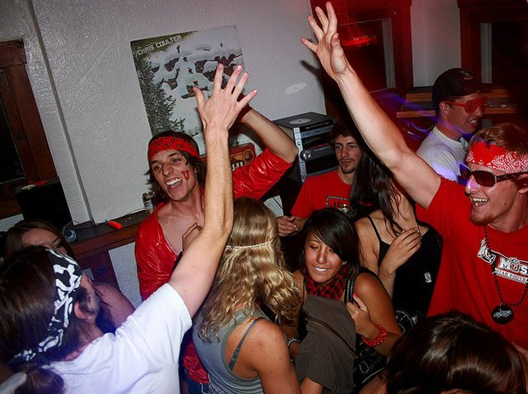

Promoting Professional Qualities and Priorities
We have a responsibility to educate students, but we also have a responsibility to the clients we serve and to the Social Work Profession.
  As field supervisors you can help us ensure our profession is the strongest it can be.
  Ask yourself, would you hire this person?
We want to help these interns move from student to professional.

Slide 42
Frequently Asked Questions (FAQs)
How many hours does the student need to complete?
  BSW I (Fall): a minimum of 150 (~10-12 hrs/wk)
  BSW II (Spring): a minimum of 300 (~20-22 hrs/wk)
  MSW I (Spring): a minimum of 425 (~28 -30 hrs/wk)
  MSW II (Fall and Spring): a minimum of 600 total
    at least 300 each semester (~20-22 hrs/wk)
    OASAS: a minimum of 700 clock hours (350 each semester (~ 23 – 25 hrs/wk)

Slide 43
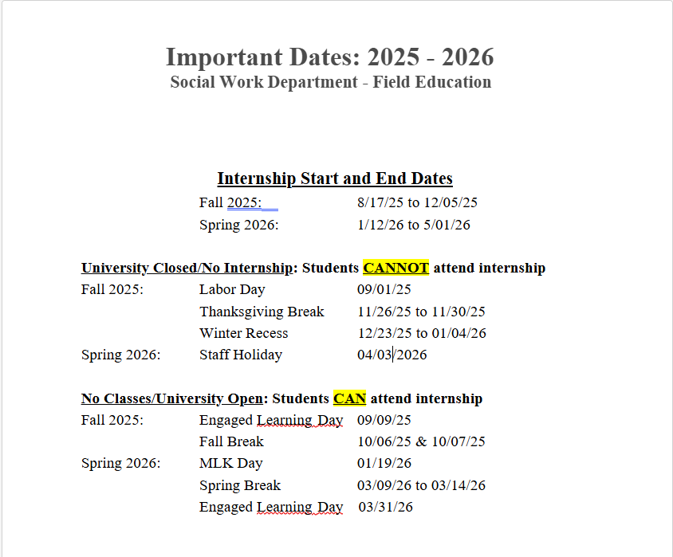
FAQs (continued)
When can the students intern?
Students can earn internship hours when the university is open and when they have supervision.
When is the University closed?
Scheduled closings are listed here. However, please note that if the university closes for an unexpected reason, such as weather, students cannot accumulate internship hours.

Slide 44
FAQs (continued)
What if my intern does not complete all their necessary hours?
Students may continue to obtain their full number of hours during finals. However, the goal is for them to have all their hours completed before finals week. Please contact the USI Faculty Field Liaison if this issue arises.
Is the student allowed to attend any events or agencies outside of the one they are interning at?
Yes, we encourage students to gain a diverse experience. We also encourage them to attend trainings and visit other agencies, while gaining field hours, if approved by the agency. (This may assist students with obtaining all their required hours.)

Slide 45
FAQs (continued)
What are the BSW Agency Field Instructor/Supervisor qualifications?
  Hold a BSW degree from an accredited school of social work
  Have an LBSW, LSW, or LCSW
  Have at least two years post BSW experience and one year in current position
  Be certified by USI Field Education
What are the MSW Agency Field Instructor/Supervisor qualifications?
  Hold an MSW degree from an accredited school of social work
  Have an LCSW
  Have at least two years post MSW experience and one year in current position
  Be certified by USI Field Education

Slide 46
FAQs: Safety
Students
Safety Slides (CSWE Requirement)
  Personal, Office, Community, and Health
Health & Safety Self-Screening
  Are you ready, healthy, and able to enter field currently?
Practicum Participation Waiver
Emergency Event Guide
  Preparation for Internship, Participation in Telehealth and/or Distance Opportunities, Behavior Expectations, Preventative Measures
Agency and Faculty
Emergency Event Guide
  Preparation for Intern, Student Participation in Telehealth and/or Distance Opportunities, Supervision Recommendations, Preventative Measures

Slide 47
FAQs: Agency vs. USI Policy
USI Policy
  The university does not require flu shots or covid vaccinations, but they are encouraged.
Agency Policy
  If your agency requires any of the above, and/or other requirements such as TB or drug testing, students must follow agency health and safety policies to intern with you.
Expect the Unexpected and Plan for It! (as much as possible ☺)

Slide 48
Pay for Placement (P4P)
  Why?:
    Hosting an intern requires additional time and energy, but once they are trained, many interns perform productive work similar to paid employees.
    Modern students have more financial responsibilities than in the past.
  Various Approaches: Paid Internship, Stipend, Agency of Employment, Grants
  Benefits: Creates a more Vested Interest and Placement Competition
  https://www.payment4placements.org/
What’s New: P4P

Slide 49
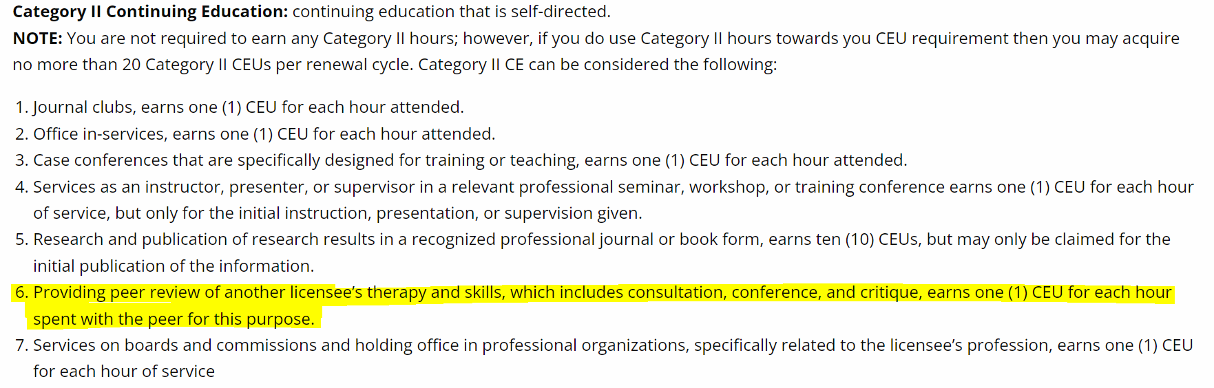
What’s New: Supervision & CEUs
Don’t have (or lost) an approved supervisor on staff?
  You can utilize a board member, volunteer, or USI faculty connected to your agency/population. They can provide supervision while an agency Task Supervisor can monitor day to day activities.
Need More Training?
  We are happy to share training materials with you or other staff that may need assistance in this area (and not just with students ☺).
Receive Category II CEUs for Providing Supervision
https://www.in.gov/pla/professions/behavioral-health-and-human-services/behavioral-health-and-human-services-licensing-information/#Continuing_Education_Categories

Slide 50
Any Additional
Questions?

Slide 51
Today’s CEUs
To receive your 1.5 CEUs for participating today, please email Rita Brunner at rbrunner@usi.edu
Once she receives your email, she will verify your attendance with our records, email you a short survey, and send you your earned CEUs via email

Slide 52

Lastly...

Slide 53
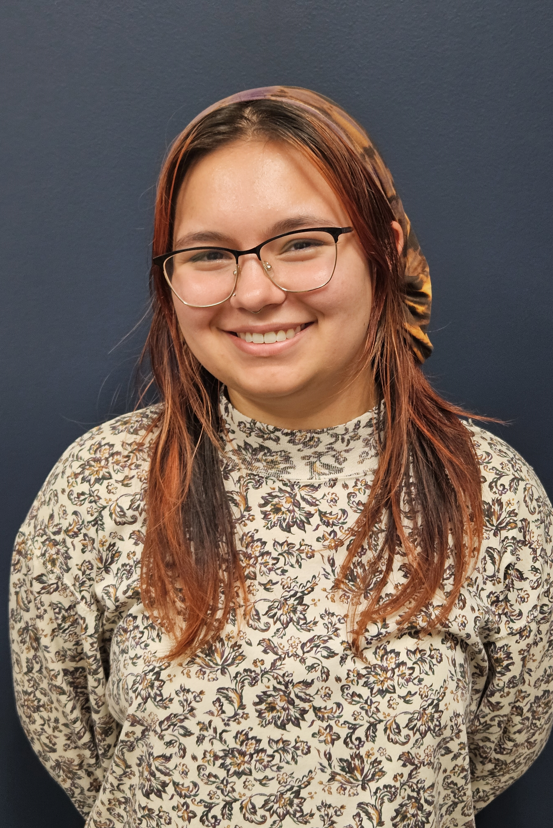

Contact the Field Education Team for questions!
Bonnie Rinks, LCSW, ACSW
Director
Field Education
812-465-1106 office
or
812-204-5848 cell
berinks@usi.edu
Brandi Watson, LCSW,
Assistant Director
Field Education
bewest@usi.edu
Grace Brown, BSW
Graduate Assistant
Field Education
812-465-7114 office
Socialwork.field@usi.edu
Madison Piatt
Student Worker
Field Education
Socialwork.field@usi.edu

Slide 54
References
Council on Social Work Education (CSWE): http://www.cswe.org/
Munson, C. E., & Munson, C. E. (2002). Handbook of Clinical Social Work Supervision. Binghamton, NY: Haworth Social Work Practice.
http://www.salisbury.edu/socialwork/FieldTraining/StudentSupervision/StudentSupervision.swf. (n.d.).
Dettlaff, A. J. (n.d.). MSW Field Supervisor Training: http://www.slideserve.com/Samuel/msw-field-supervisor-training
Pay for Placement for social work students https://www.payment4placements.org/
NASW Code of Ethics: https://www.socialworkers.org/About/Ethics/Code-of-Ethics/Code-of-Ethics-English
USI BSW & MSW Field Manuals: https://www.usi.edu/liberal-arts/social-work/field-education
A special thanks to Jara Dillingham and Summer Wilderman for their work on this training!

