Slide 1


University of Southern Indiana Career Success Center
Overview
Comprehensive Student Support via Online Resources, Career Launch Platform, and Personalized Career Coordinators
Kim Sullivan, Career Coordinator

Slide 2
What we will cover today
Online Resources
Career Launch
Career Coordinators
Notes:
As a USI student you have a lot of resources available to you from the Career Success Center.
Our webpages are full of helpful career readiness information.
You have access to Career Launch – which is our job board.
And last but definitely not least – you have us – Career Coordinators.

Slide 3
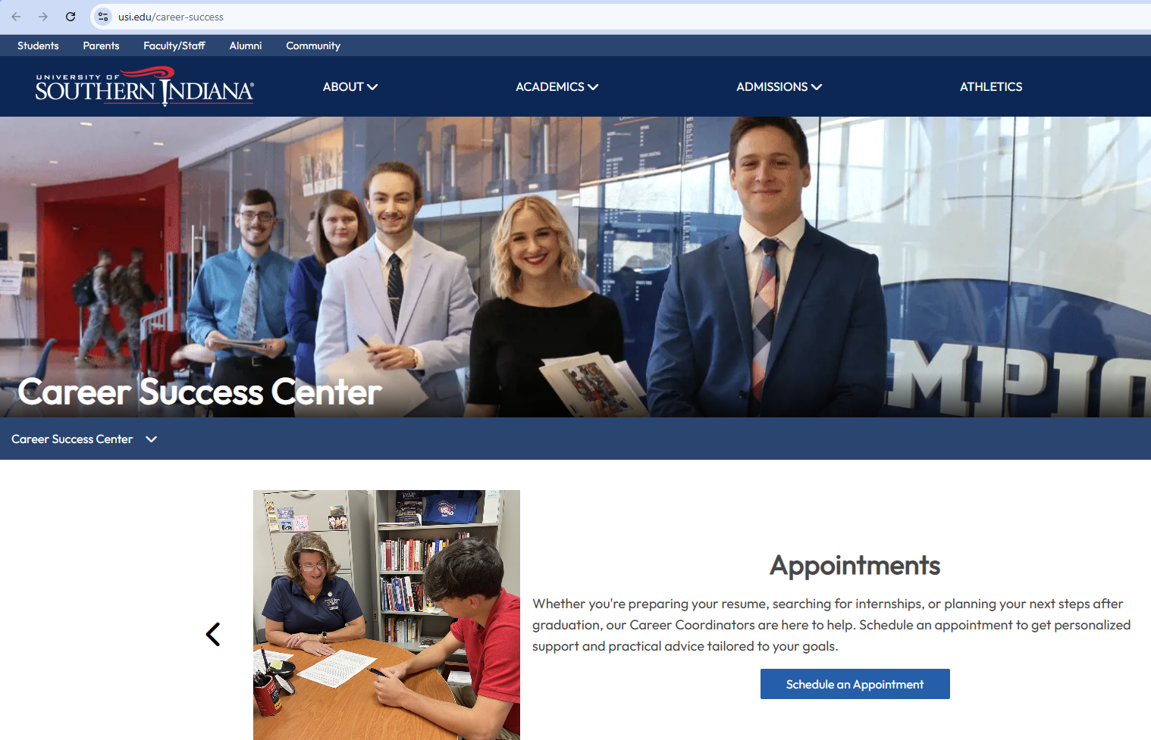
Online Resources
Usi.edu/career-success
Notes:
You can access the online resources by going to our main landing page which is usi.edu/career-success. The link is provided here. The next few slides will show you just a few of the career -readiness resources we have gathered for USI students and alumni.

Slide 4
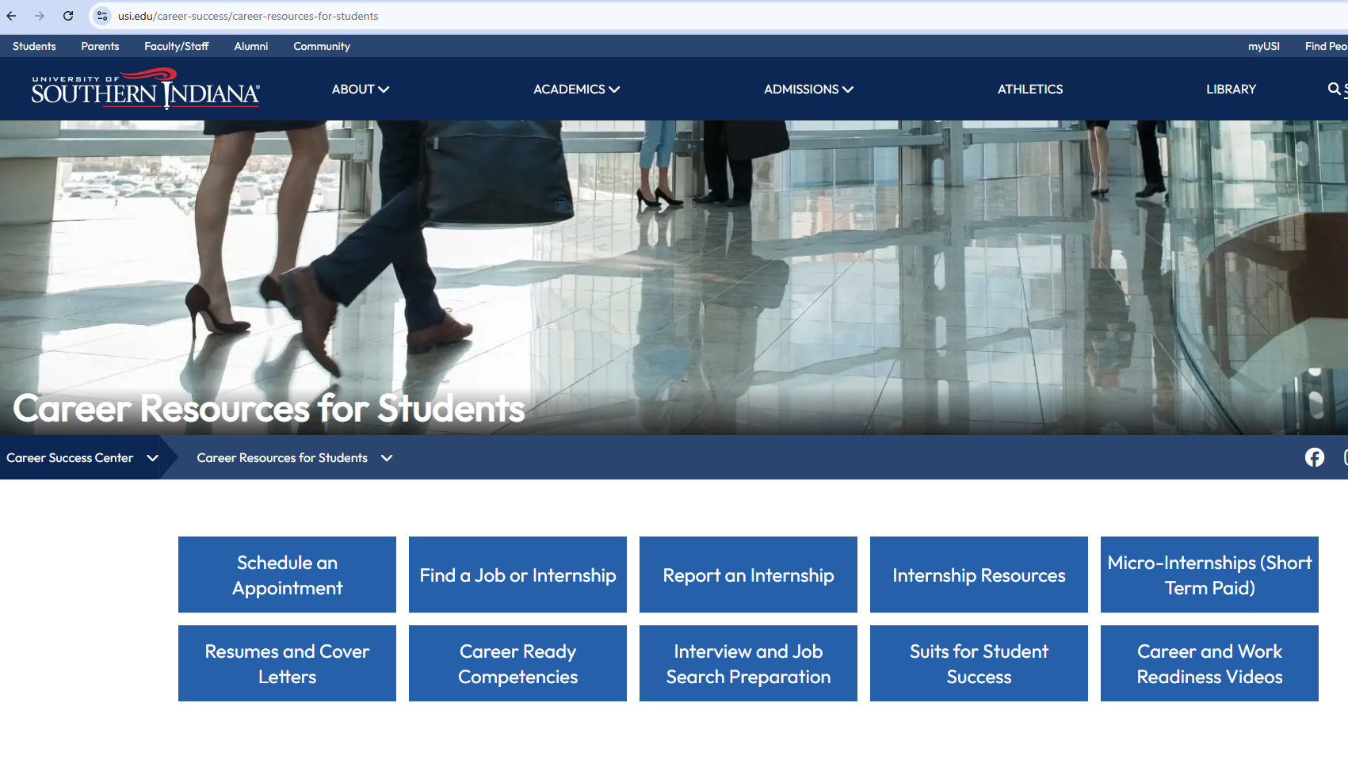
Student Resources
https://www.usi.edu/career-success/career-resources-for-students
Links! And more Links!
Sooo much information!
Let’s look at few of these…..
Notes:
From the landing page, I want you to click on Career Resources for Students.
You will see either a drop down menu or buttons on subjects such as career ready competencies, interview and job search preparation, internship resources and career and work readiness videos.
Lots of links – but for this information session, I am just going to touch on a few offerings

Slide 5

Resume and Cover Letters
Resume Development Guidelines
Action Verb List
Sample Resumes
Information about Applicant Tracking Systems
Jobscan and Skillsyncer Links
Notes:
Trying to figure out where to begin on creating or updating your resume? Click on Resume and Cover Letters.
We have created guidelines based on best practices, taking into account the use of Applicant Tracking Systems which many of today’s employers use.
What is an Applicant Tracking system? We have information about those.
Not sure what a resume should look like? we have samples.
Writer’s block? Look at our lists of Action Verbs.
Not sure why your resume is not getting any interview opportunities even though you have all the skills an employer is looking for? It may be that your resume is not scoring high enough in the company’s Applicant Tracking System – so we have links to JobScan and Skillsyncer – two resources for checking your resume to the job description.

Slide 6
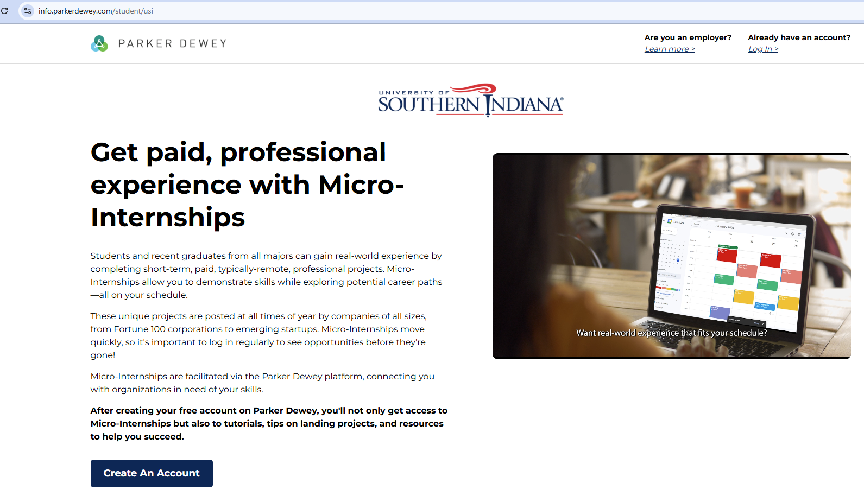
Micro-Internships
Looking for a remote, paid, micro-internship?
Check out Parker Dewey
https://info.parkerdewey.com/student/usi
Notes:
You may be looking for ways to use the education and skills you are working on in the classroom out in the world.
But with your busy life, you may not have the time to complete a full semester internship.
Consider a micro-internship. USI has partnered with Parker Dewey a national organization that provides short-term internships – think targeted projects that offer experience with pay. Also, these opportunities do not require you to be on-site.
Check out the site – link is here or can be found on the Career Success Center webpages.

Slide 7
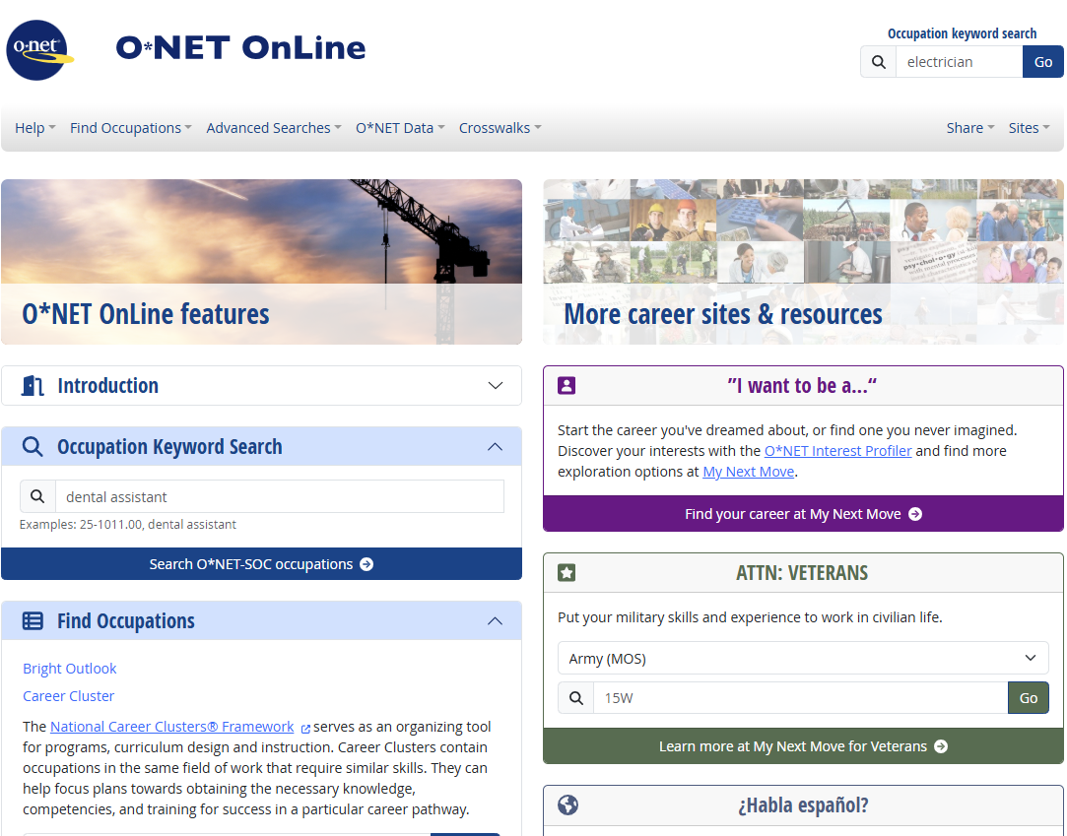
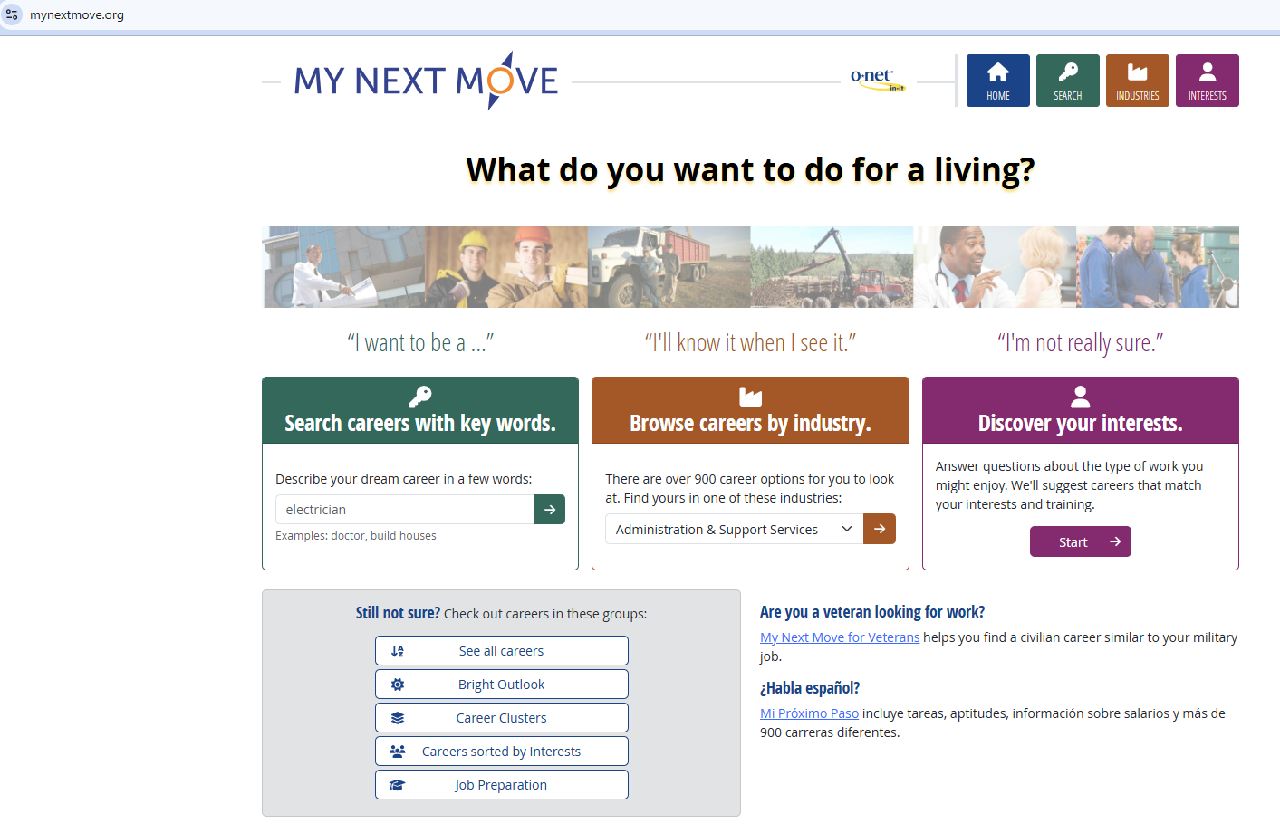
O*NET Online
Not sure what career aligns with your interests?
Want to know what a particular occupation pays in particular city and state?
Maybe you just want to browse careers, industries, and your interests.
Notes:
Our webpages have a link to O*Net which is one of my favorite sites for job searching.
Not sure what career aligns with your interests, experiences and education? Complete the ONet Interest Profiler. This exercise will take your responses and offer possible job titles.
Take the job title and find out if it is in a growing or declining field, pay ranges not only nationwide but in the location you want to live in.
Onet takes the information that is provided by the US Bureau of Labor Statistics and puts in in an easier to read format.

Slide 8

And there are even videos!
https://www.usi.edu/career-success/career-resources-for-students/career-and-work-readiness-videos
Short videos on topics such as
1. What to do before an interview
2. Building a network
3. How to set and meet career goals
Or maybe you want to watch videos specific to a field
https://usi.candidcareer.com/channels/industries/
Notes:
And the Career Success Center webpages have links to tons of videos. Anything from what to do before an interview to professionals describing a typical workday in their chosen field. Relax, grab some popcorn and beverage, and watch whatever career-readiness videos are of greatest interest to you.

Slide 9

https://www.indeed.com/job-search-services/job-search-academy-university-of-southern-indiana?from=jobseeker_marketing#hl=en
Notes:
And if the previous offerings were not enough – USI has partnered with Indeed. Click on the Job Search Academy to access a wealth of information – more career readiness webinars – as well as indeed job postings.

Slide 10

Career Launch
Your portal to appointments, job boards, and the virtual mock interview tool
Notes:
Career Launch – our job board site that also houses information about USI events and employers, the virtual mock interview tool and appointment scheduling

Slide 11
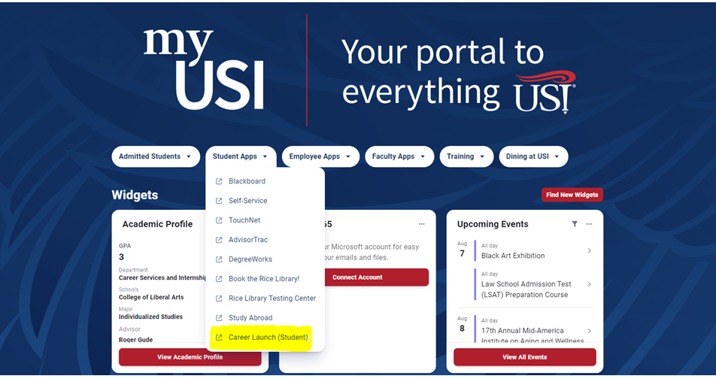

Slide 12
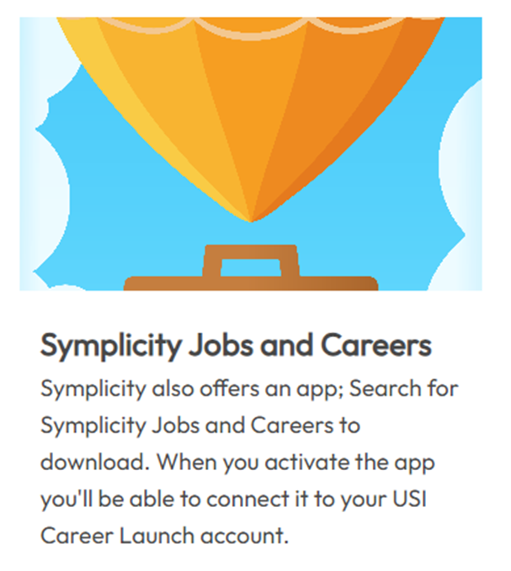
Symplicity
https://usi-csm.symplicity.com/students/app/home

Slide 13
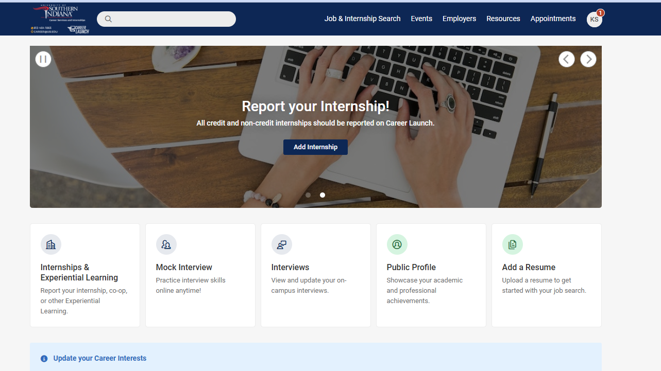
Notes:
Once you are in Career Launch, your landing page should look like this.
Along the top in blue bar are different tabs: Job & Internship Search, Events, Employers , Resources and Appointments.
The virtual mock interview tool can be accessed through the button below the scrolling photos.

Slide 14
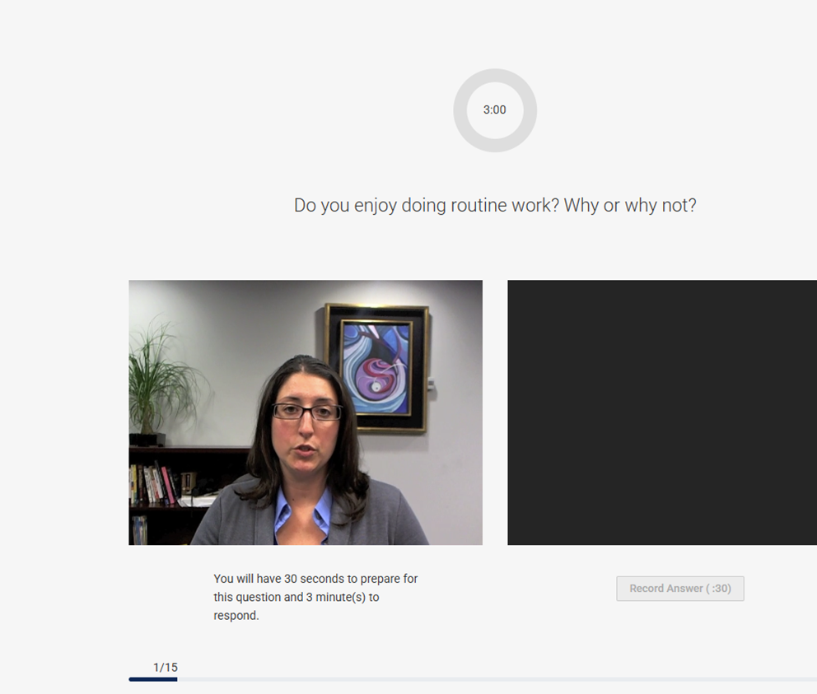
Recorded Mock Interview
Notes:
Many companies are using virtual interviews – where the interviewer is pre-recorded asking questions, and the interviewee records themselves answering the questions. Sometimes the interviewee is allowed to re-record an answer, sometimes not. Sometimes an interviewee may have a time limit imposed on answering the question.
This is a different type of interview, requiring different skills and preparation. Our mock interview tool has a large list of different types of interviews based on majors or foci. It is a wonderful way to practice this different style of interview. And Career Coordinators can review your session and provide feedback should you want it.

Slide 15
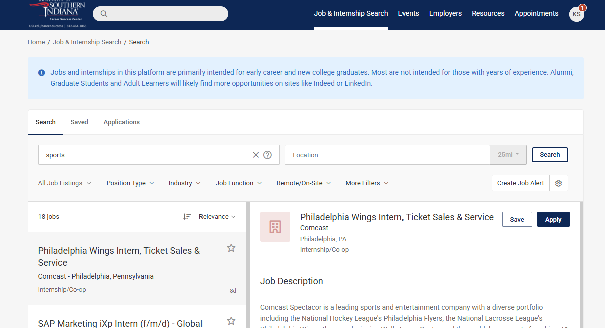
Notes:
When you click on Job & Internship Search tab, this is what will come up. You can use filters to sort through the listings. Our office does review all job postings on our website, so the listing itself is not as robust as say Indeed or ZipRecruiter. We tend to accept postings for positions in Indiana, Kentucky, Illinois and Ohio. If a Coordinator works with a student who may be looking outside the area, we tend to add those states as well – like Texas or Colorado. We also focus on majors that are available at USI and jobs that are looking for interns or recent graduates.

Slide 16
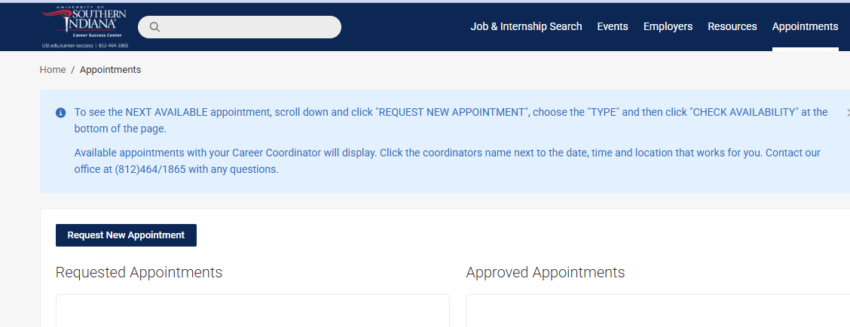
Make an Appointment
Notes:
How do I make an appointment? By clicking on the Appointments tab. Once there, click on the Request New Appointment Box and look at available times and dates for the coordinators. We do work in Central Time (think Chicago – not Indianapolis!) While the Career Coordinators are assigned to specific USI colleges, we are not limited to seeing students only from those colleges. You may make an appointment with any one of us. Please provide as much information as you can so that we can prepare. If we are working on your resume with you, please provide a copy of what you have so far! The more we are both prepared for the appointment, the more you will receive from our time together.

Slide 17
Your own personal Career Coordinator
Appointments available:
Via Zoom, phone, email, or in-person
Appts normally during the business day 9am-3pm Central Time – but we can meet at other times, just email us!
We can talk about:
Job Search
Resumes
Cover letters
Interview preparation
Social media such as LinkedIn
Any career related questions
Notes:
And what can a Career coordinator do for you?
We can talk about a host of career readiness subjects: Job search strategies, resumes, preparing for interviews, even evaluating your LinkedIn – really any career-related questions.
We are available via Zoom, phone, email or in-person. While our appointment times are usually during the business day 9am – 3pm central time, know we can schedule outside of those times if needed. Just reach out to us.
Our coordinators have a wealth of experiences and we are here to help you navigate your career journey with best practices.

Slide 18

The USI Career Success Center is here for you
Online Resources
Career Launch
Career Coordinators

Slide 19



Thank you for listening!
Questions?
Email career.center@usi.edu
Use Career Launch to schedule an appointment
Or Call (812) 464-1865

