Slide 1
Attendance Policy
Facility Operations and Planning

Slide 2
Accommodation Statement
It is the intent of the University to comply with all applicable federal, state, and local laws as amended, including but not limited to: the Family Medical Leave Act (FMLA) of 1993, the Americans with Disabilities Act (ADA) of 1990, and Section 504 of the Rehabilitation Act of 1973. Employees who believe that they may require and qualify for attendance flexibility and/or excused absences under the FMLA, ADA/504, or any other accommodation are invited to communicate their needs to Human Resources. Such requests for an exception to this attendance policy will be evaluated on an individual, case-by-case basis and may require the employee to provide Human Resources with supporting documentation.

Slide 3
Policy Statement and Expectations
Facility Operations and Planning (FOP) employees provide important and valuable services to the University of Southern Indiana (USI)
FOP desires to maintain excellent customer service to USI customers

Slide 4
Policy Statement and Expectations
In support of this goal, FOP employees are expected to:
  Arrive at work on time; remain at work until shift ends
  Respect break and meal times
  Ensure there is sufficient leave available before requesting absences
  Plan, request, and receive approval for scheduled absences in advance
  Avoid excessive unscheduled absences, pattern absences, and tardies
  Follow proper call-in procedures to report absences and tardies
  Report time accurately on timesheets
  Essential personnel have unique responsibilities

Slide 5
Definitions
Absence: time away from work for any reason
Blackout period: certain days designated by Facility Operations & Planning (FOP) leadership as critical times when employees are expected to be in attendance
No Call / No Show: an absence in which an employee does not call in to report an absence, and/or does not show up within 1 hour of the scheduled start time
Occurrence: an unscheduled absence, tardy, or failure to report to work

Slide 6
Definitions
Pattern Absences: repeated and predictable absences that indicate a misuse or abuse of time. Examples might include:
  Calling in sick on Fridays or Mondays, or the day before or after a holiday
  Calling in sick when scheduled to work on weekends, holidays, overtime, or during blackout or other critical periods
  Using sick leave as soon as it is accrued
  Requesting a vacation day, having the request denied, and then calling in sick that same day
Personal Emergency: an unscheduled absence that is unforeseen, requires immediate action, and is beyond the employee’s control

Slide 7
Definitions
Scheduled Absence: planned absence for which required advance notice is provided and approval is received prior to the absence occurring.
Tardy: failure to report for work at the assigned/scheduled time and place, or failure to return from breaks and meal periods on time. Tardy is defined as arriving any time after the scheduled shift start time, up to one hour late
Unscheduled Absence: an absence for which an employee did not obtain the required approval prior to the absence occurring. Absences on consecutive workdays for the same reason will count as one occurrence under this policy.

Slide 8
Requesting a Scheduled Absence
Amount of Time Requesting Off | Notice Required
One (1) day or less | Within the first two (2) hours of the shift one (1) working day prior
Two (2) to three (3) days off | Two (2) working days prior to the first requested day off
Four (4) to five (5) days off | One (1) week prior to the first requested day off
More than five (5) days | Two (2) weeks prior to the first requested day off
Exception: any employee scheduled to work in the Control Room or on a weekend must submit a request for a scheduled absence and receive approval for the requested absence at least 5 working days prior to the first day requested off.

Slide 9
Requesting a Scheduled Absence
Requests to use vacation, comp time, or scheduled sick leave (for a medical or dentist appointment) may be submitted via a paper slip or email to the supervisor with the following information:
  Name
  Date of request
  Date(s) or amount of time requested off
  Type of leave requesting
  In some situations, an employee may be expected to have Director approval and/or find someone to cover for them (example: Control Room)

Slide 10
Requesting a Scheduled Absence
Supervisors are expected to approve or deny requests within 24 hours or as soon as reasonably possible.
If an employee does not receive a timely response to a submitted leave request, he/she is expected to follow-up with the supervisor and confirm the approval or denial of the request before taking the time off.
If a supervisor is out of the office or otherwise unavailable to evaluate a leave request, the second level supervisor should be consulted.
  Second level supervisor = your supervisor’s supervisor

Slide 11
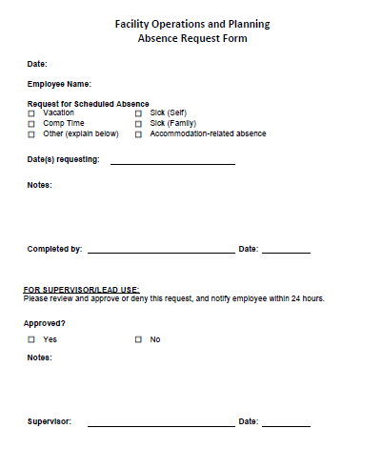
Requesting a Scheduled Absence

Slide 12
Call-in: how it works
Call the attendance line: 812-464-1766
Listen to the options
  Campus Maintenance
  Housing Maintenance
  HVAC
  Custodial
  Grounds
  Distribution Services
  Storeroom
  All other departments

Slide 13
Call-in: how it works
Select the option for your department
Leave your message
Supervisors/Leads will:
  Check the messages
  Document any unscheduled absences or tardies
  Track occurrences

Slide 14
Call-in: what to say
Name
Reason for absence
  Sick (must mention if it is FMLA)
  Family Sick (must mention if it is FMLA)
  Other (provide specific reason; must mention if it is related to an approved accommodation)
Expected date of return
Any urgent items the supervisor or department should be aware of
Number where you can be reached

Slide 15
Call-in: what to say
This is Sally. I am taking an FMLA sick day today. I expect to be back at work tomorrow. If you need anything, call me at 812-123-4567.
This is Sally. I woke up sick and need to stay home. I’m supposed to be at leadership training today; will you please let them know I won’t be there? Call me at 812-123-4567 if you need anything. I’ll try to be back tomorrow, but will keep you posted.
This is Sally. My child is sick and has to stay home from school, so I am going to use family sick leave today. I hope to be back tomorrow. Call me at 812-123-4567 if you need something.

Slide 16
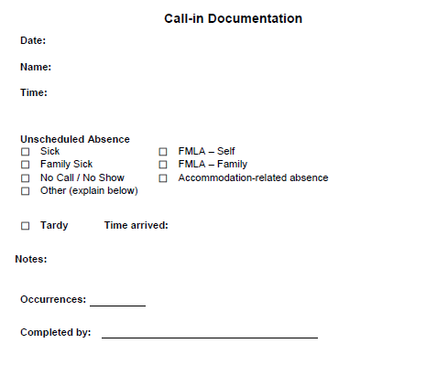
Call-in: documentation
Supervisors and/or Leads will track unscheduled absences and tardies

Slide 17
Occurrences
Each time an employee has an unscheduled absence, is tardy, or fails to report to work, the employee will accrue one (1) occurrence
Four (4) or more occurrences in a quarter is considered excessive
Occurrences will be tracked on a quarterly basis
  Quarter 1: January, February, March
  Quarter 2: April, May, June
  Quarter 3: July, August, September
  Quarter 4: October, November, December
An absence that spans multiple days for the same reason will be counted as one (1) occurrence
  Example: you have the flu and miss 3 days of work. The 3 absences will count as 1 occurrence.

Slide 18
Occurrences
No occurrences will be recorded for scheduled, pre-approved absences OR protected leave
  Vacation requested and approved in advance
  Sick leave requested and approved in advance (e.g., medical/dentist appt.)
  FMLA absences
  Absences related to an approved accommodation
  Occupational illness or injury (workers’ compensation)
  Military leave
  Bereavement leave
  Jury duty

Slide 19
Occurrences
Once an employee has accrued four (4) occurrences within one quarter, the supervisor will notify the Associate Director of FOP and HR
Occurrence | Discipline Step and Action
4 occurrences in a quarter | Step 1: Verbal Counseling
6 occurrences in a quarter | Step 2: Written Warning
8 occurrences in a quarter | Step 3: Last and Final Warning
10 occurrences in a quarter | Step 4: Recommend Termination

Slide 20
Occurrences
If an employee has been previously disciplined under the University’s Progressive Discipline Policy for any reason, the totality of the circumstances will be assessed when determining further action
  Example: employee has a Written Warning on file for Unprofessional Behavior and then accrues 6 attendance occurrences within one quarter.

Slide 21
Occurrences: Example 1
Attendance-related discipline will remain on an employee’s record for 12 months and will drop a level 12 months after the last action
Quarter | Occurrence | Action
January, February, March 2018 | 4 occurrences | Verbal Counseling after 4th
April, May, June 2018 | 3 occurrences | None Supervisor will still address issue and communicate attendance expectations.
July, August, September 2018 | 1 occurrence | None
October, November December 2018 | 4 occurrences | Written Warning
January, February, March 2019 | None | None
April, May, June 2019 | 4 occurrences | Last and Final Warning

Slide 22
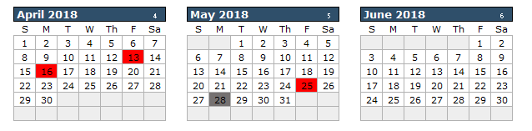
Occurrences: Example 1 – Pattern Absence
Pattern absences may include calling in sick on a Friday or Monday, or the day before or after a holiday
Suspected pattern absences may result in the accrual of an occurrence(s)

Slide 23
Occurrences: Example 2
Quarter | Occurrence | Action
January, February, March 2018 | 7 occurrences | Verbal Counseling after 4th Written Warning after 6th
April, May, June 2018 | None | None
July, August, September 2018 | None | None
October, November, December 2018 | 2 occurrences | None
January, February, March 2019 | 2 occurrences | None
April, May, June 2019 | None | None
July, August, September 2019 | 5 occurrences | Written Warning after 4th It has been more than 12 months since the last action, so the action drops a level Written Warning is re-issued

Slide 24
Occurrences: Example 3
Quarter | Occurrence | Action
January, February, March 2018 | 2 occurrences | None
April, May, June 2018 | 3 occurrences | None
July, August, September 2018 | 2 occurrences | None
October, November, December 2018 | 6 occurrences | Verbal Counseling after 4th Written Warning after 6th
January, February, March 2019 | 3 occurrences | None
April, May, June 2019 | 3 occurrences | None
July, August, September 2019 | 4 occurrences | Last and Final Warning
October, November, December 2019 | None | None
January, February, March 2020 | 3 occurrences | None
April, May, June 2020 | 4 occurrences | Recommend Termination

Slide 25
Occurrences: Example 4
Quarter | Occurrence | Action
January, February, March 2018 | 2 occurrences | None
April, May, June 2018 | 3 occurrences | None
July, August, September 2018 | 4 occurrences | Verbal Counseling
October, November, December 2018 | 6 occurrences | Written Warning after 4th Last and Final Warning after 6th
January, February, March 2019 | 3 occurrences | None
April, May, June 2019 | 3 occurrences | None
July, August, September 2019 | 2 occurrences | None
October, November, December 2019 | 4 occurrences | Recommend Termination

Slide 26
New Hires
An FOP employee that accrues two (2) occurrences within the 45- or 90-day Introductory Period will be issued a Written Warning
If more than 2 occurrences are accrued in the Introductory Period, termination of employment may be recommended.
If an Introductory Period is extended beyond the initial 45 or 90 days, the same guidelines apply.

Slide 27
Occurrences: New Hire Example 1
Quarter | Occurrence | Action
January, February, March 2018 | 2 occurrences | Written Warning after 2nd
April, May, June 2018 | 3 occurrences | None
July, August, September 2018 | 2 occurrences | None
October, November December 2018 | 6 occurrences | Last and Final Warning after 4th Recommend termination after 6th

Slide 28
Occurrences: New Hire Example 2
Quarter | Occurrence | Action
January, February, March 2018 | 2 occurrences | Written Warning after 2nd
April, May, June 2018 | 3 occurrences | None
July, August, September 2018 | 2 occurrences | None
October, November December 2018 | 2 occurrences | None
January, February, March 2019 | 2 occurrences | None
April, May, June 2019 | 4 occurrences | Written Warning It has been more than 12 months since the last action, so the action drops a level and the Written Warning is re-issued

Slide 29
Occurrences: New Hire Example 3
Quarter | Occurrence | Action
January, February, March 2018 | 4 occurrences | Written Warning after 2nd Recommend Termination after 4th

Slide 30
No Call / No Show
Per University policy, an employee who fails to call in and report to work as scheduled for three consecutive workdays will be viewed as having abandoned their position and employment will be terminated.
FOP defines a no call / no show as an incident in which an employee does not call in to report an absence and/or does not show up within one hour of his/her scheduled start time
If a FOP employee is a no call / no show, the supervisor or Lead is expected to reach out to the employee as soon as practical. Our primary objective is to ensure the employee’s safety and well-being. If contact if made with the employee, the supervisor should inquire if the employee plans to report to work and, if so, when.

Slide 31
No Call / No Show
An employee who does not report to work or call in within the first hour of their scheduled shift, but then reports to work within the first four (4) hours of their scheduled shift, will accrue two (2) occurrences.
An employee who does not report to work or call in within the first hour of their scheduled shift, and does not come to work at all, will accrue four (4) occurrences.

Slide 32
Making Up Missed Time
An employee that is tardy or has an unscheduled absence will not be allowed to make up the missed time during the work week in which the occurrence occurred
Depending on the time the employee reports to work, he/she may be required to use vacation time or comp time to cover the time missed (reported in increments of .25 hours). Sick leave should be used if the tardy or unscheduled absence was a result of illness or a medical/dental appointment, per the University Handbook.

Slide 33
Making Up Missed Time
Exception: an employee with a pre-approved (scheduled) medical or dentist appointment may request to make up a maximum of two (2) hours of worktime
  Request must be approved in advance by supervisor
  There must be available work that the employee can perform
  The made-up time must fall within the same work week as the appointment

Slide 34
Absences with No Available Leave
If an employee does not have any available leave or comp time to cover an entire absence, he/she will fall into unpaid leave status and will be subject to disciplinary action
Each incident of unpaid leave that is not protected under any law or University policy will accrue four (4) occurrences
If an employee has a need for unpaid leave, it must be approved in advance per University policy.
  Example: new hires who have pre-planned vacations; approved Personal Leave of Absence (PLOA)

Slide 35
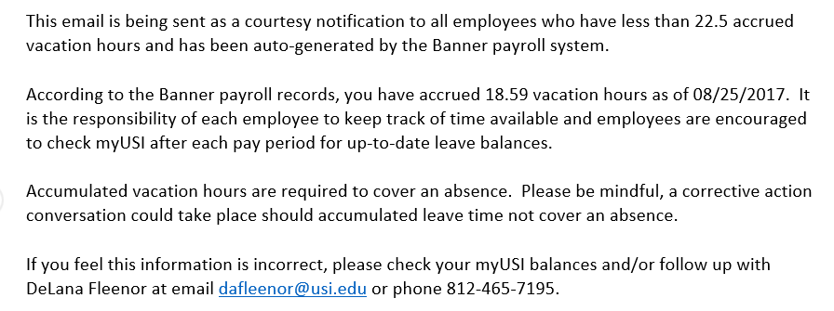
Low Leave Balance Warning
Employees that have less than 22.5 accrued vacation OR sick hours receive an automatic email from Payroll

Slide 36
Checking Leave Balances
Employees are responsible for knowing their leave balances and ensuring they have available leave to cover absences
Leave balances can be checked via:
  myUSI
  Pay stubs

Slide 37
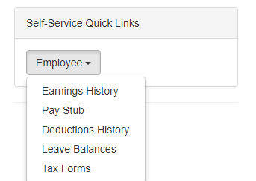
Checking Leave Balances: myUSI
Go to www.usi.edu and click myUSI
Log into myUSI using your logon credentials
Go to Self-Service Quick Links and select Employee > Leave Balances

Slide 38
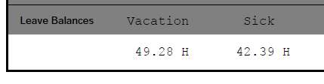
Checking Leave Balances: Pay Stub
Open your Payroll Direct Deposit Advice
Your leave balances are printed in the bottom left hand corner

Slide 39
Overtime
An occurrence will be given if a FOP employee:
  Fails to show for scheduled overtime
  Leaves early without approval from scheduled overtime

Slide 40
Blackout Periods
Requests for scheduled absences will not be permitted or authorized during blackout periods
  A written request for an exception of an extremely rare, extenuating circumstance may be submitted
  Exceptions are subject to review and approval of the Associate Director of FOP in collaboration with the Supervisor
Other absences that occur during blackout periods may be subject to verification
Blackout periods are subject to change. Blackout periods may be added or deleted. As much notification as possible will be provided.

Slide 41
Blackout Periods
Department | Blackout Periods
Custodial (all shifts) | Week of Fall and Spring Commencement (4/21/19 – 4/26/19) and ( 12/1/19 – 12/6/19) First week of Fall and Spring semesters (8/18/19 – 8/23/19) and (1/12/20 – 1/17/20)
Distribution Services | NONE
Grounds | Week of Spring Commencement (4/22/19 – 4/26/19) Week of Move-In and Week of Move-Out (4/29/19 – 5/3/19) and (8/12/19 – 8/16/19) Spring Spruce-up Day (4/7/19)
Housing Facility Operations (includes Custodial, Grounds, Maintenance) | Spring Blitz (first week of May) (5/3/19 – 5/5/19) Weekend before Move-In, Week of Move-In Week, and Weekend after Move-In (8/10/19 – 8/18/19)
HVAC | Weekend before, week of, and weekend after Fall Move-In (8/10/19 – 8/18/19) Those scheduled in Control Room may have separate blackout periods (e.g., holidays)
Maintenance | NONE
New Harmony | Heritage Artisans Day event (3rd full week of April – Tuesday to Thursday) Maintenance staff required the week before the event and work days(s) prior to the event (4/8/19 – 4/12/19 and 4/15/19) Custodial staff required the 3 days of the event, and the Saturday after the event (4/16/19 - 4/18/19 and 4/20/19)
Storeroom | NONE

Slide 42
Minimum Staffing
FOP departments must operate with minimum staffing levels in order to provide important and critical services
In general, 2/3 of a department’s total staff constitutes minimum staffing and a Lead or Supervisor should be present
If several employees request the same day off, the supervisor reserves the right to determine which request(s) will be approved or denied. Criteria may include:
  Which request was submitted first
  Whether the department will have minimum staffing numbers
  Whether the employee followed the notice guidelines outlined in this policy

Slide 43
Minimum Staffing
If a department’s staffing will fall below minimum levels, the supervisor must notify and obtain permission from the Associate Director or Director of FOP before operating below minimum staffing levels.

Slide 44
Essential Personnel
USI defines essential personnel as those vital to the operation of the facility, whose absence from duty could endanger the safety and well-being of the campus population and/or physical plant
A position’s designation as essential is communicated during the hiring process and documented in job descriptions
Essential personnel receive an annual e-mail reminder on or around December 1

Slide 45
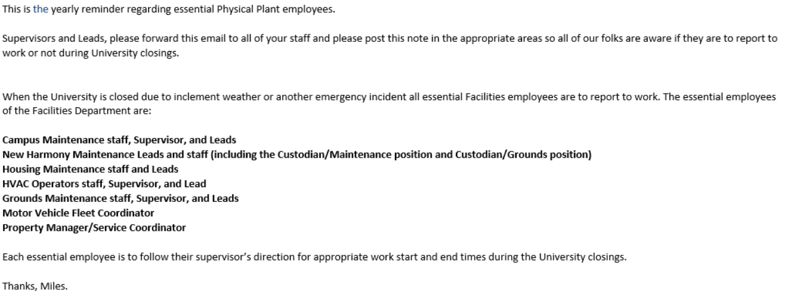
Essential Personnel
The annual reminder regarding essential Facility Operations and Planning employees was sent to Supervisors and Leads on 11/13/18

Slide 46
Essential Personnel
Supervisors will notify essential personnel if they need to report to work
  If inclement weather is forecast throughout the night, staff may be notified before they leave work what time they are expected to report in the morning
  Supervisors will need to call or text employees to ensure they know to come in
  Supervisors are responsible to maintain an updated employee contact list
  Employees are responsible to notify supervisors of any changes in their contact information
  Employees must answer calls/texts or return them in a reasonable timeframe
Essential personnel may be required to report for essential duty (e.g., report to work before the scheduled shift start time or stay after the scheduled shift end-time) if inclement weather or another emergency is forecast, but there is no cancellation, delayed opening, or closing.

Slide 47
Essential Personnel
Essential personnel will accrue four (4) occurrences if they fail to report to work or leave work early without approval
For safety purposes, FOP employees whose responsibilities may require them to work more than 12 consecutive hours in a 24-hour period must obtain approval from the Director of FOP before exceeding 12 hours.
  While this primarily applies to essential personnel who may be required to work significant overtime to ensure the safety of the campus or physical plant, this rule applies to all FOP employees regardless of their position’s essential designation

Slide 48
Holidays
FOP employees must request AND receive approval for a scheduled absence before and/or after an USI holiday at least two (2) working days prior to the holiday
Documentation may be required to excuse an absence the day before, the day of, or the day after a holiday
Per University policy, if an employee is in unpaid leave status the day before or after a paid holiday, they are ineligible for holiday pay

Slide 49
Leadership Discretion
The Association Director of FOP and HR to evaluate extraordinary circumstances and determine if an incident will count as an occurrence
Any exceptions approved by the Associate Director or Director will still be documented

Slide 50
Questions?

